Slide 1
Weather Dataset Aarhus Denmark DS-670
Rhonald Reside
Competitors Article Presentation

Slide 2
Content
Introduction
Data Set Introduction and Data Processing
Competitor Article
Background
Methods
Experimental Set-up
Results
Limitations
How to make it better
Data Visualizations
Conclusion

Slide 3
Data Set Introduction and Data Processing
This dataset contains weather data from a city in Aarhus in Denmark.
This dataset is collection of seven variables that measure different aspects of the weather in that city.
The data is all time synced.
The data set came in a JSON file format

Slide 4
Data Set Introduction and Data Processing
The weather data is separated by two sets of dates.
The first range of the weather data set is February 2014 to June of 2014.
The second set of the weather data set is in August 2014 to September 2014.

Slide 5
Data Set Introduction and Data Processing
Weather data set came with seven different types of variable.
It came in with Dew Point, which was in degrees Celsius.
Humidity was the next variable which came in percentage.
Pressure was the next variable which came in the measurement of mBar.
Temperature was the next variable which was measured in degrees Celsius.
Wind direction was the next set of variables which was came in the measurement of degrees.
Wind speed is the next variable, which was measured in kilometers per hour.
The final variable was visibility.

Slide 6
Data Set Introduction and Data Processing
It was necessary to convert the data from JSON to CSV
Data was cleaned and structured in Excel.
I discovered that each measurement was also time stamped
I combined all the data into a dataframe so that I can work with it in other tools

Slide 7
Competitor Article
The article I am going to make better is:
The Relationship between Relative Humidity and Dewpoint Temperature in Moist Air
Reference
Lawrence, Mark G (2005). The Relationship between Relative Humidity and Dewpoint Temperature in Moist Air : A Simple Conversion and Applications: Bulletin of the American Meteorological Society: Vol 86, No 2. Journals.ametsoc.org http://journals.ametsoc.org/doi/abs/10.1175/BAMS-86-2-225

Slide 8
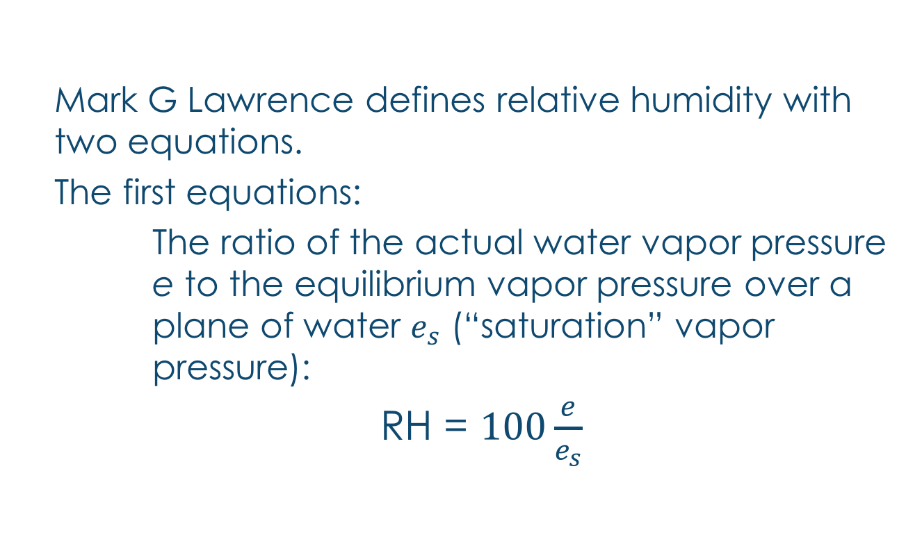
Background
Mark G Lawrence defines relative humidity with two equations.
The first equations:
The ratio of the actual water vapor pressure e to the equilibrium vapor pressure over a plane of water $e_{s}$ (“saturation” vapor pressure):
RH = $100\frac{e}{e_{s}}$

Slide 9
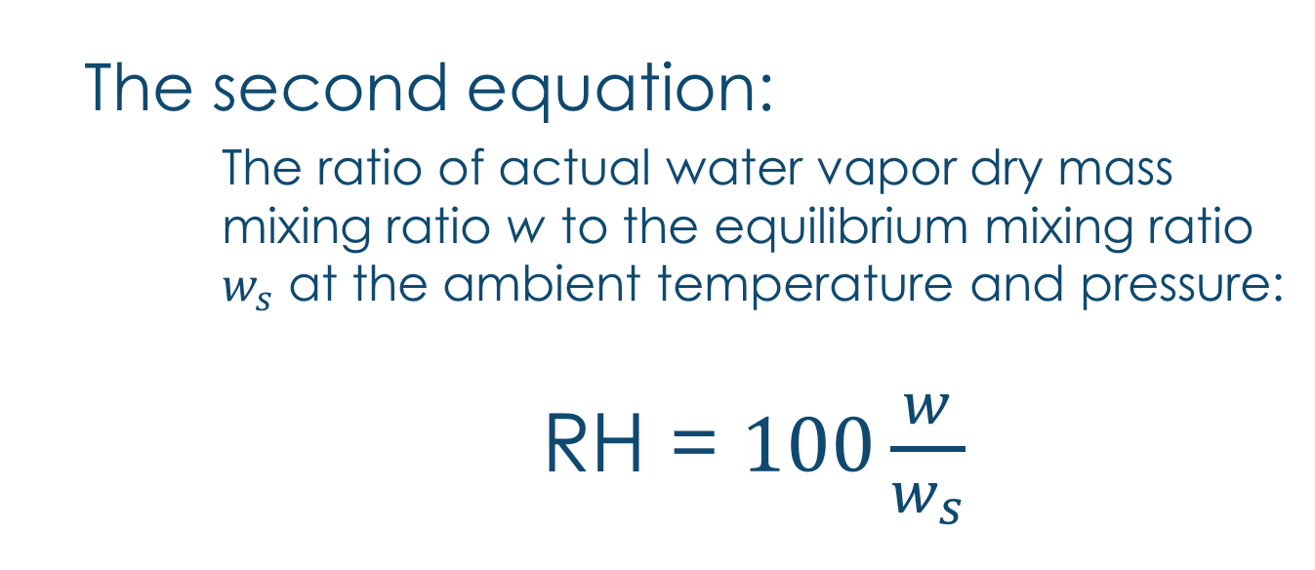
Background
The second equation:
The ratio of actual water vapor dry mass mixing ratio w to the equilibrium mixing ratio $w_{s}$ at the ambient temperature and pressure:
RH = $100\frac{w}{w_{s}}$

Slide 10

Background
Part of his study is a linear regression for moist air. He states that RH > 50% becomes nearly linear.
RH = $100exp\left[−\frac{L}{R_{w}TT_{d}}(T−T_{d})\right]$

Slide 11
Background
The authors first defines what is relative humidity.
“The relative humidity (RH) and the dew point temperature are two widely used indicators of the amount of moisture in the air”
It is the amount of water vapor in the air expressed in percentages of the amount needed for the saturation at the same temperature

Slide 12
Questions
The author has two questions he wants to ask:
How are the dewpoint temperature and relative humidity related?
Is there an easy and sufficient way to convert between them without using a calculator or computer?

Slide 13
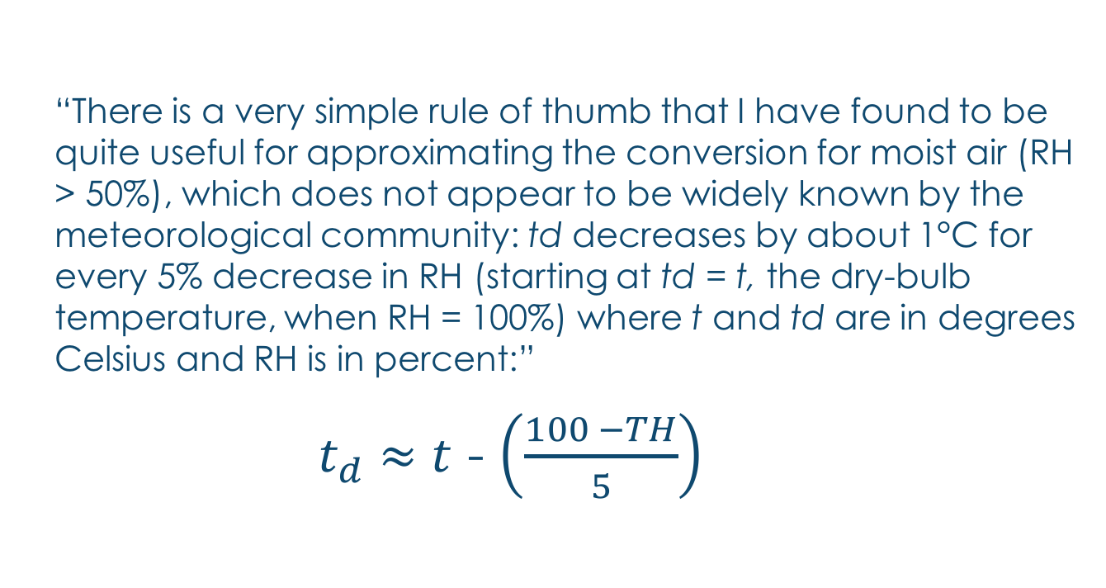
Author’s Set-up
“There is a very simple rule of thumb that I have found to be quite useful for approximating the conversion for moist air (RH > 50%), which does not appear to be widely known by the meteorological community: td decreases by about 1°C for every 5% decrease in RH (starting at td = t, the dry-bulb temperature, when RH = 100%) where t and td are in degrees Celsius and RH is in percent:”
$t_{d}$ $≈$ $t$ - $\left(\frac{100 −TH}{5}\right)$

Slide 14
Results
Error rate of <5%, (basic range of RH ~90% vs 70%)
Direct relationship between temperature, humidity and dew point

Slide 15
Limitations
We are not provided a data set that he uses in his study
There are other variable that can affect RH (i.e. air pressure or wind speed)

Slide 16
How to make it better
I would look at other models that show a relationship, not just the two equations.
Use measurements from different locations to prove consistency in the equations

Slide 17
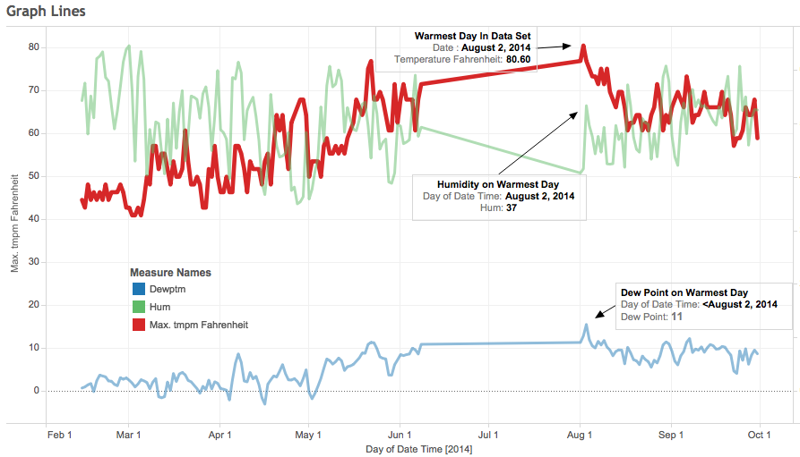
Data Visualization graph of Dew Point, Humidity and Temperature

Slide 18
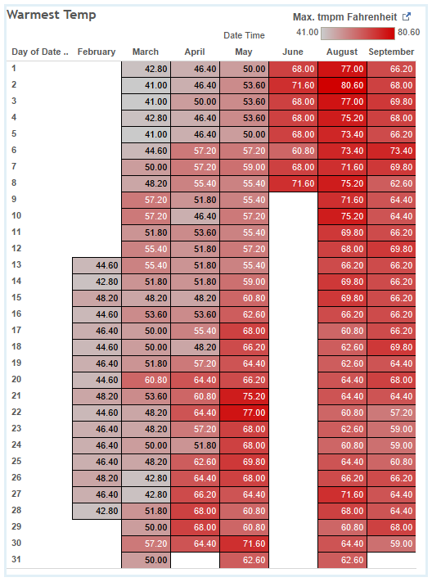
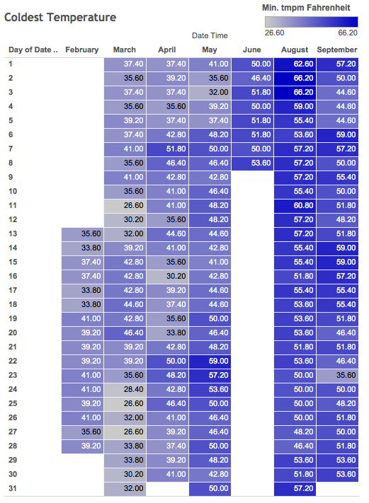
Data Visualization Warmest and Coldest Days

Slide 19
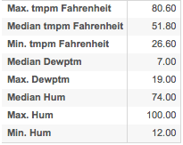
Data Visualization statistics on Dew Point, Humidity and Temperature

Slide 20
Conclusion
From the dataset, the warmest day was on August 2, 2014 at 80.6⁰ F, with average humidity of 37 and dew point of 11.
Coldest day was on March 11 at 26.6⁰ F, with average humidity of 84 and dew point of -4.

